Slide 1
Regression Analysis
Multiple Linear Regression
Nicoleta Serban, Ph.D.
Professor
School of Industrial and Systems Engineering
Ranking States by SAT Performance: Regression Analysis

Slide 2

About This Lesson

Slide 3
Linear Regression Analysis in R
regression.line = lm(sat ~ takers + rank + income + years + public + expend)
summary(regression.line)
Coefficients:
Estimate Std. Error t value Pr(>|t|)
(Intercept) -94.659109 211.509584 -0.448 0.656731
takers -0.480080 0.693711 -0.692 0.492628
rank 8.476217 2.107807 4.021 0.000230 ***
income -0.008195 0.152358 -0.054 0.957353
years 22.610082 6.314577 3.581 0.000866 ***
public -0.464152 0.579104 -0.802 0.427249
expend 2.212005 0.845972 2.615 0.012263 *
---
Signif. codes: 0 ‘***’ 0.001 ‘**’ 0.01 ‘*’ 0.05 ‘.’ 0.1 ‘ ’ 1
Residual standard error: 26.34 on 43 degrees of freedom
Multiple R-squared: 0.8787, Adjusted R-squared: 0.8618
F-statistic: 51.91 on 6 and 43 DF, p-value: < 2.2e-16

Slide 4
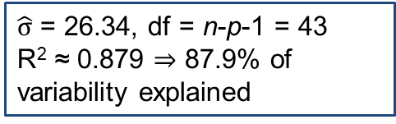
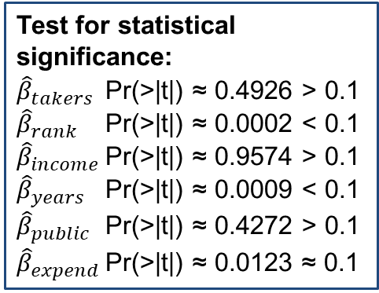
Linear Regression Analysis in R
regression.line = lm(sat ~ takers + rank + income + years + public + expend)
summary(regression.line)
Coefficients:
Estimate Std. Error t value Pr(>|t|)
(Intercept) -94.659109 211.509584 -0.448 0.656731
takers -0.480080 0.693711 -0.692 0.492628
rank 8.476217 2.107807 4.021 0.000230 ***
income -0.008195 0.152358 -0.054 0.957353
years 22.610082 6.314577 3.581 0.000866 ***
public -0.464152 0.579104 -0.802 0.427249
expend 2.212005 0.845972 2.615 0.012263 *
---
Signif. codes: 0 ‘***’ 0.001 ‘**’ 0.01 ‘*’ 0.05 ‘.’ 0.1 ‘ ’ 1
Residual standard error: 26.34 on 43 degrees of freedom
Multiple R-squared: 0.8787, Adjusted R-squared: 0.8618
F-statistic: 51.91 on 6 and 43 DF, p-value: < 2.2e-16
Test for statistical significance:
${\hat{β}}_{takers}$ Pr(>|t|) ≈ 0.4926 > 0.1
${\hat{β}}_{rank}$ Pr(>|t|) ≈ 0.0002 < 0.1
${\hat{β}}_{income}$ Pr(>|t|) ≈ 0.9574 > 0.1
${\hat{β}}_{years}$ Pr(>|t|) ≈ 0.0009 < 0.1
${\hat{β}}_{public}$ Pr(>|t|) ≈ 0.4272 > 0.1
${\hat{β}}_{expend}$ Pr(>|t|) ≈ 0.0123 ≈ 0.1
$\hat{σ}$ = 26.34, df = n-p-1 = 43
R² ≈ 0.879 ⇒ 87.9% of variability explained

Slide 5
Testing for Subsets of Coefficients
## Compare models: reduced with controlling variables only vs. full with all variables
anova(regression.line)
Analysis of Variance Table
Response: sat
Df Sum Sq Mean Sq F value Pr(>F)
takers 1 181024 181024 260.8380 < 2.2e-16 ***
rank 1 11209 11209 16.1512 0.0002313 ***
income 1 2858 2858 4.1182 0.0486431 *
years 1 16080 16080 23.1701 1.86e-05 ***
public 1 252 252 0.3631 0.5499447
expend 1 4745 4745 6.8369 0.0122629 *
Residuals 43 29842 694
## compute partial-F statistic
fstat = ((2858+16080+252+4745)/4)/(29842/43)
pvalue = 1-pf(fstat,4,43)
pvalue
[1] 3.349778e-05

Slide 6
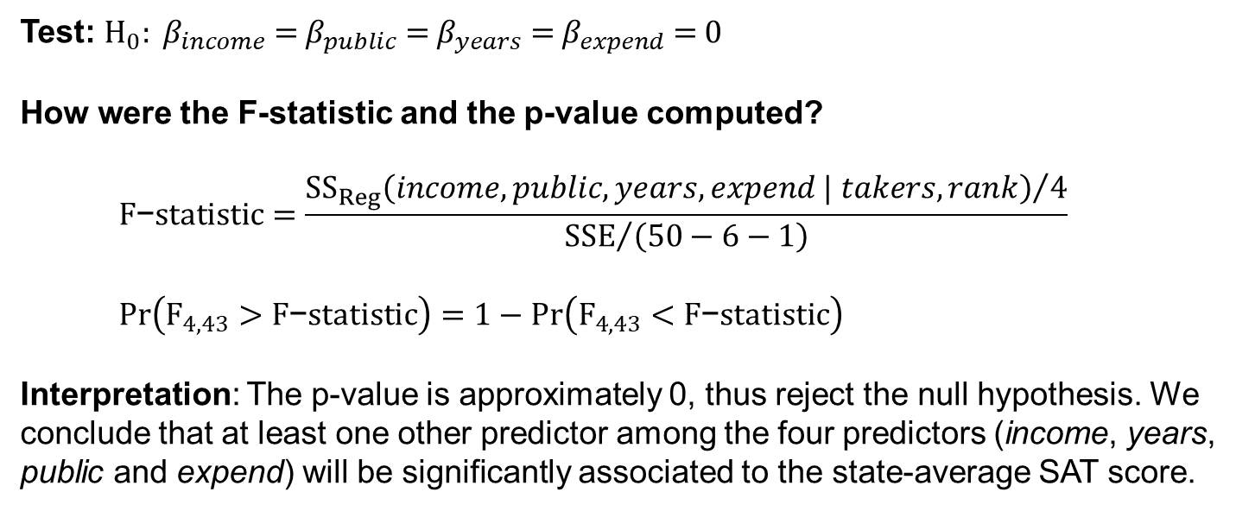
Testing for Subsets of Coefficients
Test: $H_{0}: β_{income}\text{ = }β_{public}\text{ = }β_{years}\text{ = }β_{expend}\text{ = 0}$
How were the F-statistic and the p-value computed?
$$F\text{−}statistic=\frac{{{SS}_{Reg}\left(income, public, years, expend | takers, rank\right)}/4}{{SSE}/{\left(50−6−1\right)}}$$
$$Pr\left(F_{4, 43}>F\text{−}statistic\right)=1−Pr\left(F_{4, 43}<F\text{−}statistic\right)$$
Interpretation: The p-value is approximately 0, thus reject the null hypothesis. We conclude that at least one other predictor among the four predictors (income, years, public and expend) will be significantly associated to the state-average SAT score.

Slide 7
Using Residuals to Create Better Rankings
Bias Selection: Some state universities require the SAT and some require a competing exam. States with a high proportion of takers probably have “in state” requirements for the SAT. In states without this requirement, only the more elite students will take the SAT, causing a bias.
## Consider model with the two controlling factors to correct for bias
reduced.line = lm(sat ~ takers + rank)
## obtain the order of states by the residuals of the reduced model
order.vec = order(reduced.line$res, decreasing = TRUE)
## Reorder states. Create table including state name, new and old order.
states = factor(data[order.vec, 1])
newtable = data.frame(State = states, Residual = as.numeric(round(reduced.line$res[order.vec], 1)), oldrank = (1:50)[order.vec])
newtable

Slide 8
Using Residuals to Create Better Rankings
State Residual oldrank
1 Connecticut 53.9 35
2 Iowa 53.5 1
3 NewHampshire 45.8 28
4 Massachusetts 41.9 41
5 NewYork 40.9 36
6 Minnesota 40.6 7
7 Kansas 35.8 4
8 SouthDakota 33.4 2
⋮
43 Arkansas -31.2 12
44 WestVirginia -38.9 25
45 Nevada -45.4 30
46 Mississippi -49.3 16
47 Texas -50.3 45
48 Georgia -63.0 49
49 NorthCarolina -71.3 48
50 SouthCarolina -98.5 50
After controlling for selection bias, Connecticut moved from 35th to 1st.
After controlling for selection bias, Mississippi moved from 16th to 46th.

Slide 9

Summary

